Slide 1
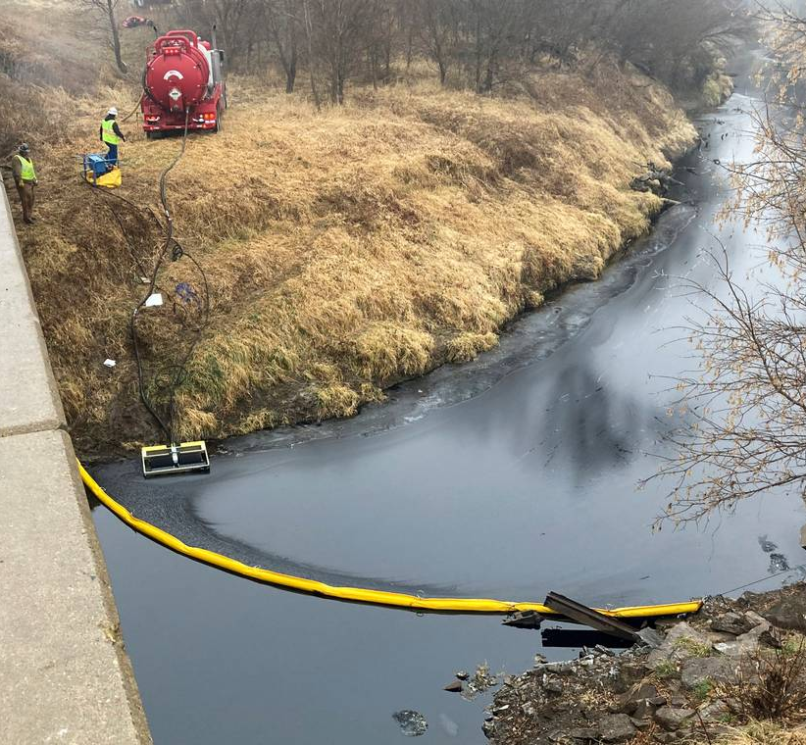
The MA Wetlands Regulations & the MA Contingency Plan
Massachusetts Department of Environmental Protection
Photo credit: The Kansas City Star, www.kansascity.com

Slide 2
Introduction
Purpose of the MA Contingency Plan
Overview of Wetlands Regulations
Review specific regulatory requirements that pertain to the Massachusetts Contingency Plan (310 CMR 40)
Emergencies
Permitting
Next steps

Slide 3
Massachusetts Contingency Plan (310 CMR 40)
The purposes of the Massachusetts Contingency Plan are, without limitation, to:
(a) provide for the protection of health, safety, public welfare and the environment
(b) encourage persons responsible for releases and threats of release of oil and/or hazardous material to undertake necessary and appropriate response actions in a timely way;
(c) focus government resources on those sites at which the person(s) responsible can not or will not undertake necessary response actions;
(d) focus government resources on those sites at which Department oversight is necessary to ensure that response actions are protective of health, safety, public welfare and the environment;
(e) establish a program for the Department to issue Tier I Permits to persons seeking to carry out response actions at Tier I disposal sites; and
(f) establish a program for the Department to audit a sufficient number of response actions not overseen or conducted by the Department to ensure that those response actions are performed in compliance with M.G.L. c. 21E, 310 CMR 40.0000 and other applicable laws.

Slide 4
Massachusetts Wetlands Protection Act (WPA) and Regulations
The Act: Mass. General Laws, Chapter 131, Section 40
The Regulations: 310 CMR 10.00

Slide 5
310 CMR 10.01(2) Purpose of the WPA
Protection of public and private water supply
Protection of ground water supply
Flood control prevention
Storm damage prevention
Prevention of pollution
Protection of land containing shellfish
Protection of fisheries
Protection of wildlife habitat

Slide 6
Areas Subject to Protection (310 CMR 10.02):
(a) Any bank, freshwater wetland, beach, dune, flat, marsh or swamp BORDERING the ocean or any estuary, creek, river, stream, pond or any lake;
(b)Land under any of the water bodies listed above
(c) Land subject to tidal action
(d) Land subject to coastal storm flowage
(e) Land subject to flooding
(f) Riverfront area

Slide 7
Inland Wetlands (Freshwater)
Bank, 10.54
Bordering Vegetated Wetland, 10.55
Land Under Water, 10.56
Land Subject to Flooding,10.57 (Bordering and Isolated)
Riverfront Area, 10.580.58

Slide 8
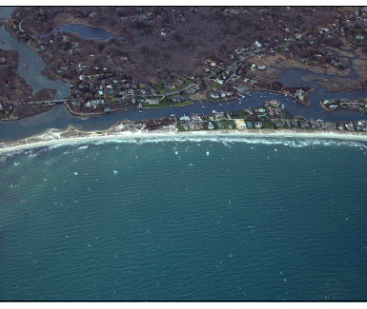
Riverfront Area
200 feet from a perennial river or stream
measured horizontally from mean annual high-water level
Does not have a buffer zone
Is a wetland resource area

Slide 9
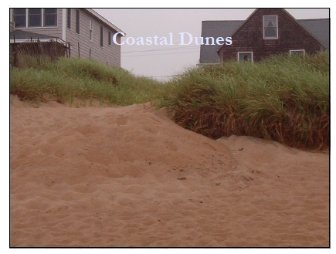
Coastal Wetlands
Salt marsh
Beach
Dune
Coastal Bank
Flat (mud flat)
Land Under the Ocean
Land Subject to Coastal Storm Flowage

Slide 10
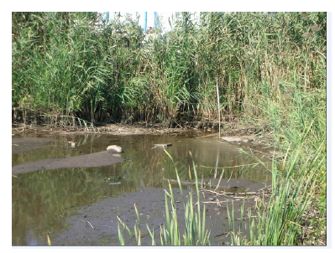
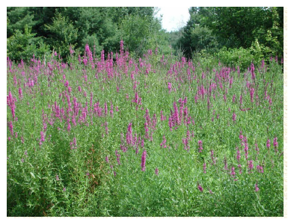
Buffer Zone
Buffer Zone: land extending 100 feet horizontally outward from the boundary of any BVW, inland bank, coastal bank, coastal beach, dune or flat.

Slide 11
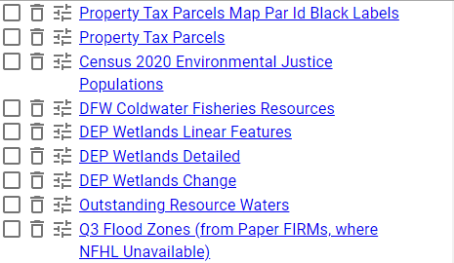
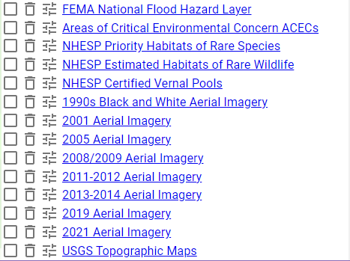
MassMapper layers
https://maps.massgis.digital.mass.gov/MassMapper/MassMapper.html
Historic aerials
Don’t forget “DEP Wetlands Linear Features”
Helpful MassMapper Layers
Local GIS data
Previous delineations on this or adjacent parcels?

Slide 12
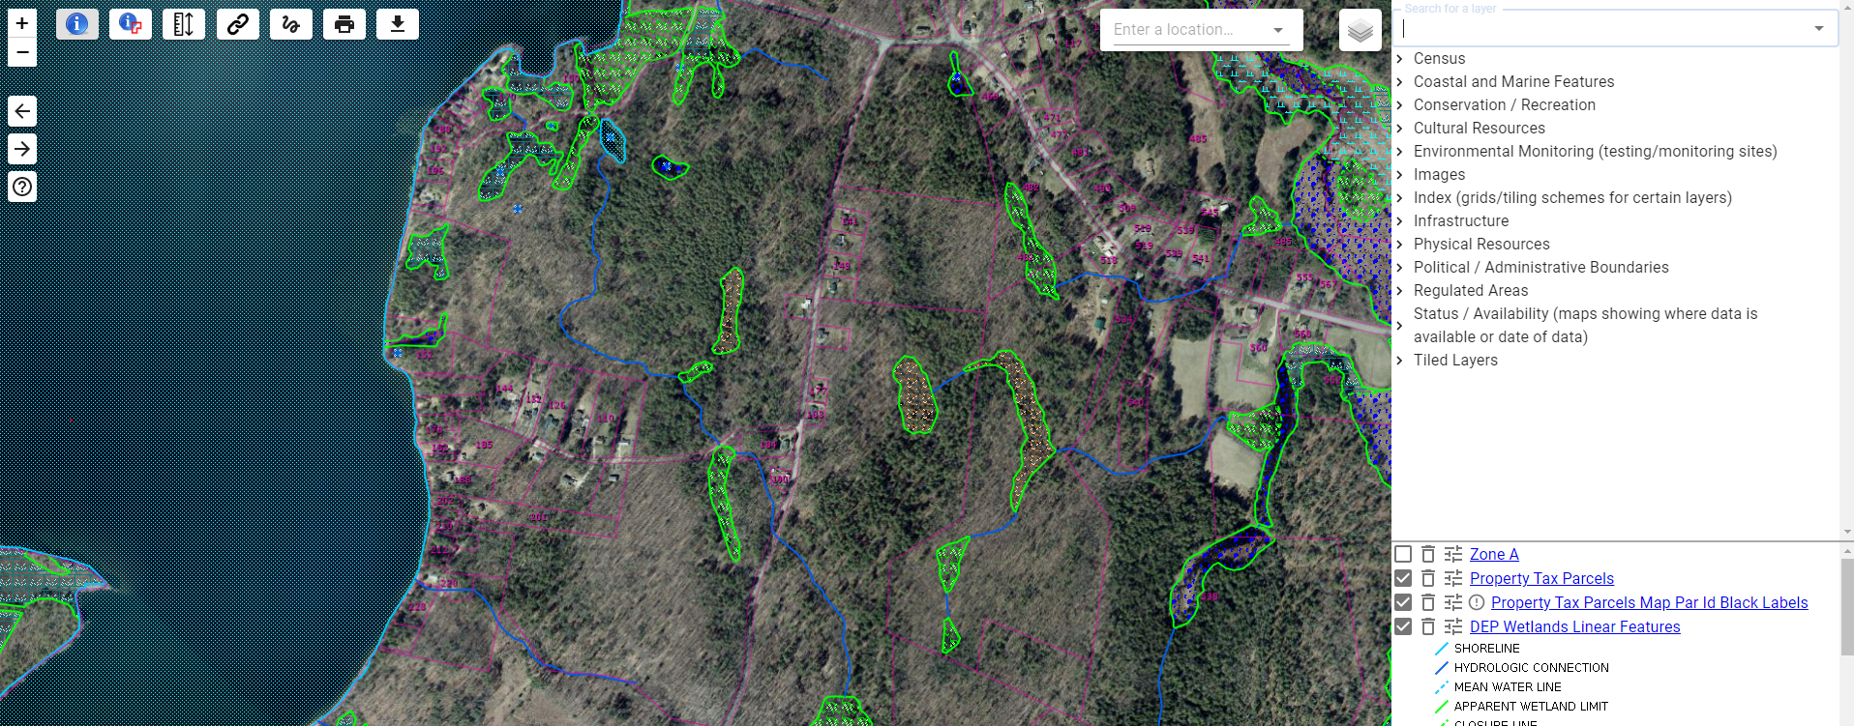
MassMapper Layers: DEP Wetlands Linear Features and DEP Wetlands Detailed

Slide 13
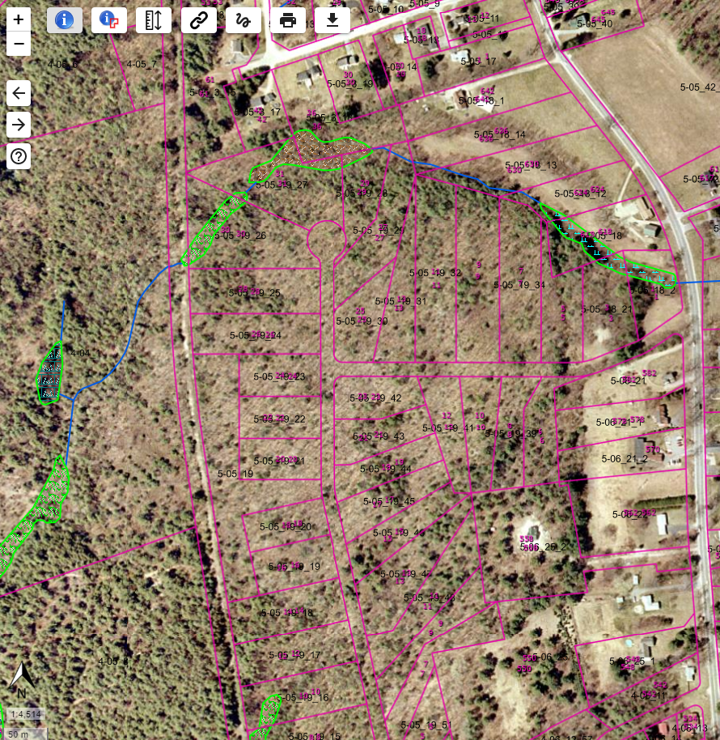
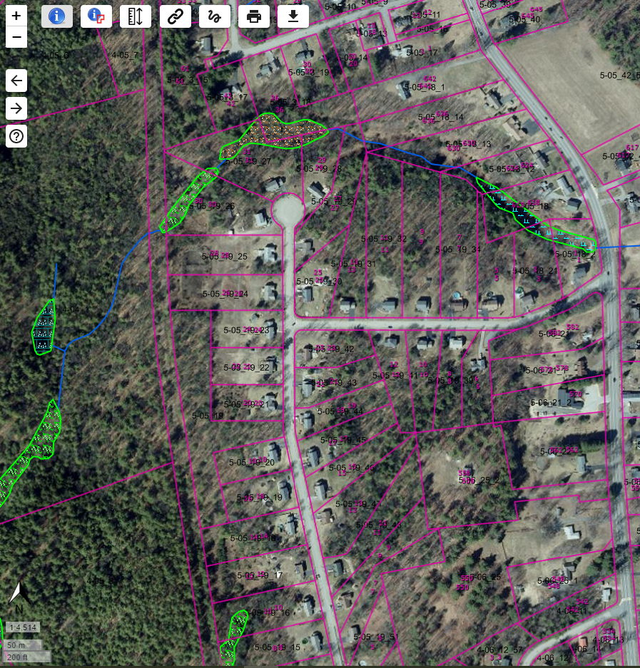
MassMapper: Historical Aerials

Slide 14
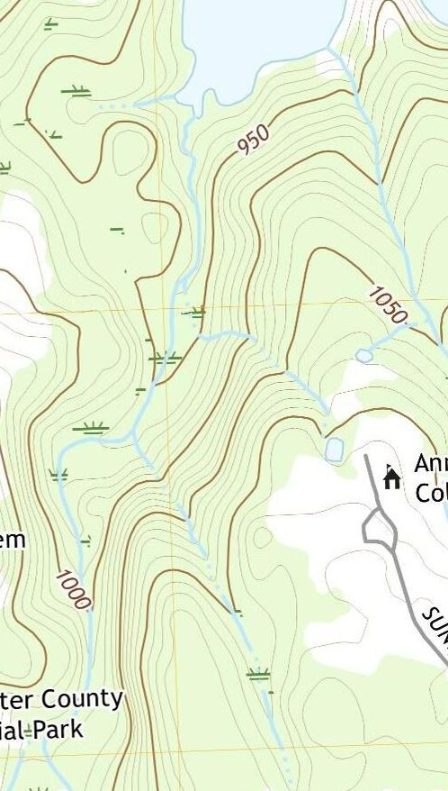
Topographic Maps
MassMapper/Paper (1983)
USGS National Map (Current)
USGS TopoView (2021)

Slide 15
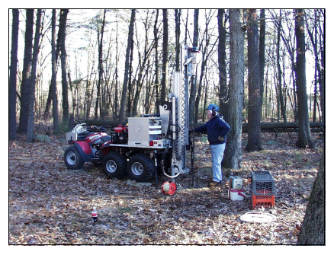
Activities Subject to Regulation
Except for minor activities, ANY activity proposed or undertaken within an area specified in 310 CMR 10.02 (1) (all wetland areas listed) and which will remove, fill, dredge, alter that area… requires the filing of a Notice of Intent.

Slide 16
Alter: change the condition of
change drainage characteristics, flushing, salinity, flow pattern, sedimentation patterns, etc.
lowering water level
destruction of vegetation
change in water temp, BOD, other physical, biological or chemical characteristics of receiving water

Slide 17
Activities Outside Jurisdiction
are not subject to jurisdiction….
UNLESS and UNTIL that activity alters a wetland.

Slide 18
Minor activities/exemptions for work in Buffer Zone*
Activities that are temporary in nature, have negligible impacts, and are necessary for planning and design purposes, such as
installation of monitoring wells
exploratory borings
sediment sampling
surveying
*BZ ONLY. If within a resource area, then the activity is not minor nor exempt

Slide 19
/
Are there wetland resource areas on the site or within 100 feet of the site?
Is there a perennial river within 200ft?
Will the work dredge, fill, remove or alter a wetland resource area?
Access possible without a wetland crossing?

Slide 20
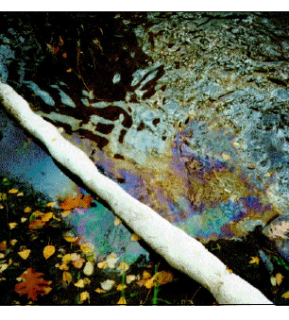
10.06 Emergencies
Request must specify what agency of the state or town will perform the project or has ordered the work.
Only for public health/safety.
Emergency work not to exceed 60 days for approved Immediate Response Action (IRA)
MassDEP may, on its own or at the request of any person, review any certificate that is approved by the local Conservation Commission or denied, or if the Conservation Commission fails to act within 24-hours.
Only to abate the emergency.

Slide 21
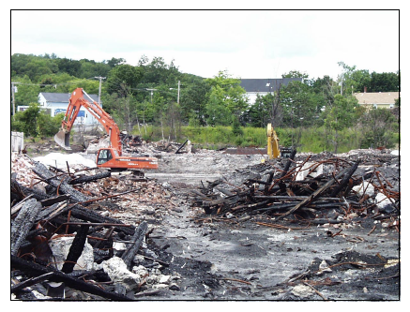
10.06 Emergencies – Immediate Response Actions
(7) Notwithstanding any other requirements, IRAs receiving oral approval from BWSC to 310 CMR 40.0420(2), or initiated up to 24 hours prior to notification to and oral approval by BWSC pursuant to 310 CMR 40.0420(7) and (8), may commence before requesting the conservation commission to issue an emergency certification under 301 CMR 10.06, so long as the request is made within 24 hours after the BWSC has orally approved the commencement of the IRA.

Slide 22
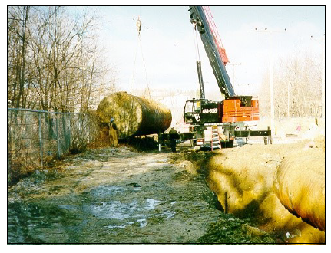
10.06 Emergencies – Immediate Response Actions Continued
Once a request for emergency certification has been made pursuant to 310 CMR 10.06(7), work that commenced before such filing may continue pending a decision on the request by the conservation commission.
Such work may also continue pending a decision on a request for DEP review UNLESS the request has not been filed with the DEP within one business day of: issuance by the local Conservation Commission of the emergency certification; Conservation Commission denial of the emergency certification; or failure by a Conservation Commission to act within 24 hours of a request for emergency certification.

Slide 23
Permitting Procedures
Determination of Applicability
ANRAD
Notice of Intent
Fees

Slide 24
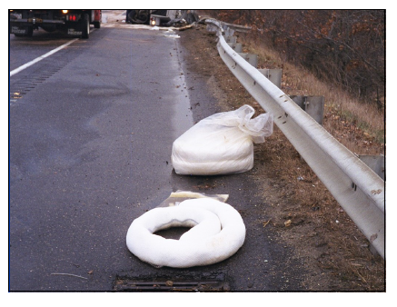
Notice of Intent
Any person who proposes to do work that will remove, fill, dredge or alter any Area Subject to Protection under M.G.L. Ch. 131, §40 shall file a Notice of Intent…

Slide 25
Limited Projects Provisions 310 CMR 10.53(3)(q)
There are no practicable alternatives that are consistent with the provisions of 310 CMR 40.0000 AND that would be less damaging to the resource areas…
Assessment, monitoring, containment, mitigation, and remediation of, or other response to, a release or threat of release of oil and/or hazardous material in accordance with the provisions of 310 CMR 40.0000
No such measure may be permitted which is designed in accordance with the provisions of 310 CMR 40.1020 solely to reduce contamination to a level lower than that which is needed to achieve “No Significant Risk” as defined in 310 CMR 40.0006(10)
Alternative analysis required

Slide 26
310 CMR 10.53(3)(q) Alternatives Analysis
Shall include, but is not limited to,
alternative that does not alter wetland, which will provide baseline data for evaluating other alternatives;
an assessment of alternatives to both temporary and permanent impacts to wetlands…

Slide 27
Limited Projects Provisions Continued 310 CMR 10.53(3)(q)
A “Comprehensive Remedial Action Alternative” that meets MCP shall be deemed to have met the requirements of the 310 CMR 10.53(q)(1); and…
Such projects shall be designed, constructed, implemented, operated, and maintained to avoid or, where avoidance is not practicable, to minimize impacts to resource areas;
and shall meet the following standards to the maximum extent practicable:

Slide 28
Maximum Extent Practicable under 310 CMR 10.53(3)(q)
hydrological changes minimized
BMPs to prevent erosion
mitigating measures that contribute to the protection of wetland interests
compensatory flood storage required
no restriction of flows & no increase in flood stage or velocity…
temporary structures/roads removed within 30 days of completion
substantial restoration of resource areas (75% in 2 years)
work in resource areas only when ground is frozen, dry or otherwise stable.

Slide 29
10.03(7) Fees
Installation of monitoring well
Any activity associated with the cleanup of hazardous waste, except as otherwise noted in Category 4, including excavation, destruction of vegetation, change in subsurface hydrology, placement of collection wells or other structures for collection and treatment of contaminated soil and/or water.
Any alteration of a resource area to divert water for the clean up of a hazardous waste site.
Any activities, including the construction of structures, associated with the assessment, monitoring, containment, mitigation, and remediation of, or other response to, a release or threat of release of oil and/or hazardous material reviewable under 301 CMR 10.53(3)(q).

Slide 30
Appeals
10.05(7) Request for Actions by the Department (Superseding Determinations, SOCs)
310 CMR 1.00 Adjudicatory Proceedings

Slide 31
Additional Procedural Regulations
10.05 (8) Extensions of Orders of Conditions
10.05 (9) Certificates of Compliance

Slide 32
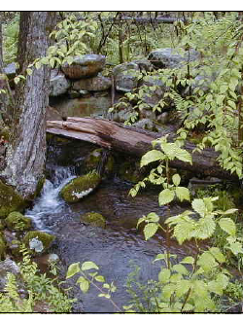
More information? Project specific questions?
MassDEP Regional Offices and Website:
https://www.mass.gov/orgs/massachusetts-department-of-environmental-protection
Call your MassDEP Circuit Rider:
https://www.mass.gov/info-details/massdeps-wetlands-circuit-rider-program
Local Conservation Commission
Association of Massachusetts Wetland Scientists

